Slide 1


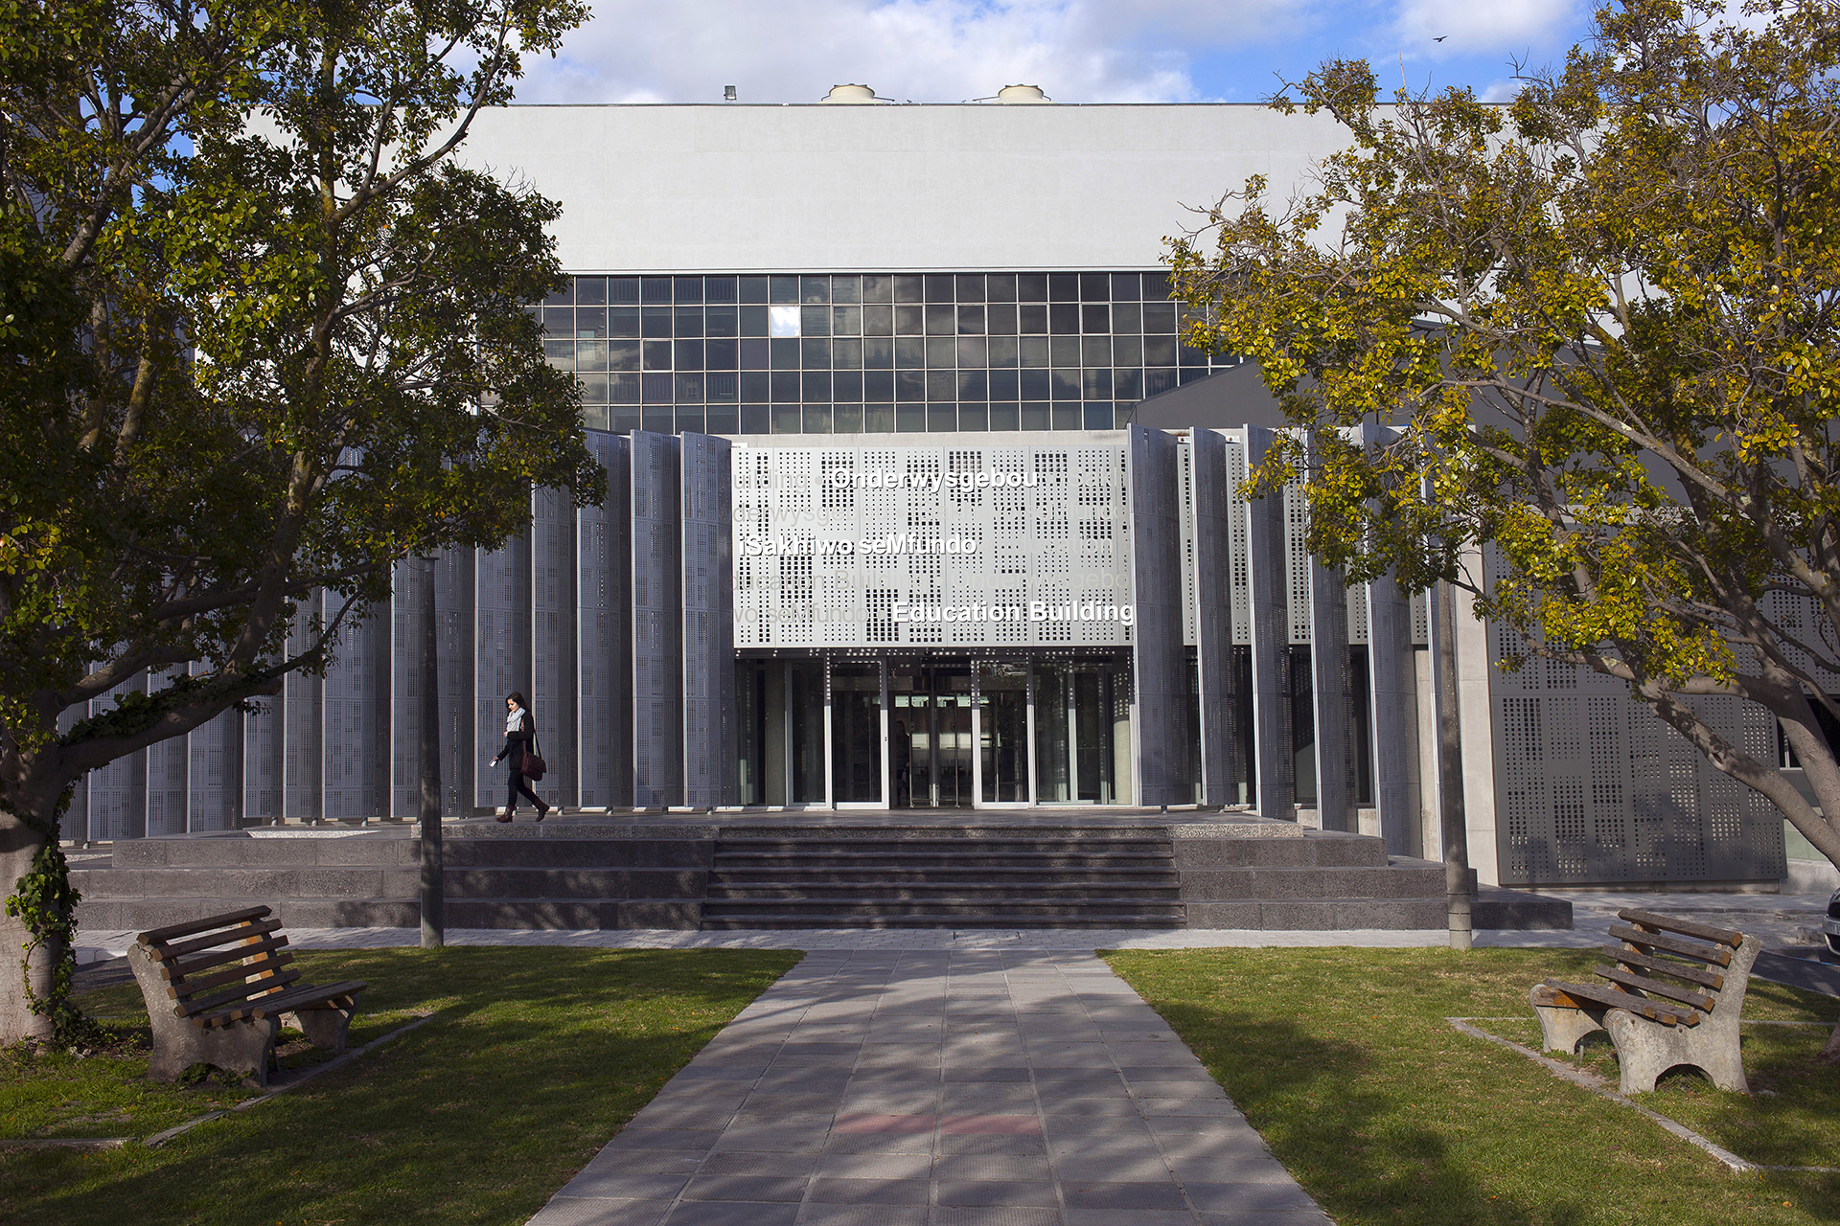
Measuring VQ Mismatch Saadiq Moolla Post-TB CARE Stellenbosch University
Photo by Stefan Els

Slide 2
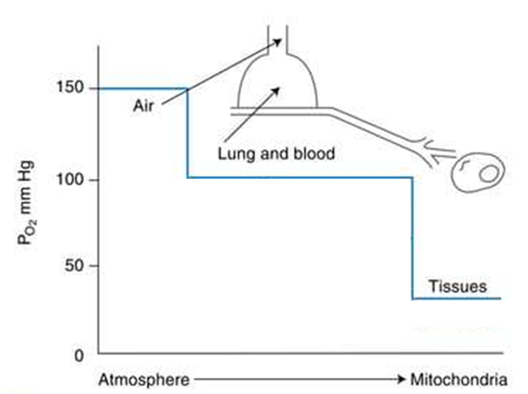
O₂ Transport to the Tissues
20 kPa
13 kPa
West’s Respiratory Physiology (10th ed)

Slide 3
Causes of Hypoxaemia
Low F_{i}O₂
Hypoventilation
Diffusion limitation
Shunt
Ventilation-perfusion (VQ) mismatch
20 kPa
13 kPa
West’s Respiratory Physiology (10th ed)

Slide 4
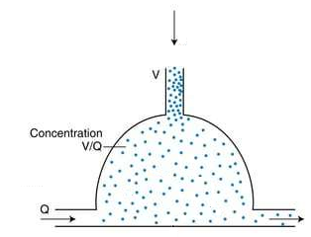
The VQ Ratio
O₂ is “continuously” added by breathing (ventilation, V)
O₂ is continuously taken up in the blood (perfusion, Q)
The ratio of these two rates (VQ) determines the concentration of O₂
Ultimately determines P_{a}O₂
Ideal ratio: 0.8
Applies to other gasses, eg. CO₂
West’s Respiratory Physiology (10th ed)

Slide 5
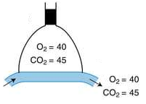
No Ventilation
West’s Respiratory Physiology (10th ed)

Slide 6
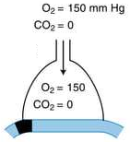
No Perfusion
West’s Respiratory Physiology (10th ed)

Slide 7
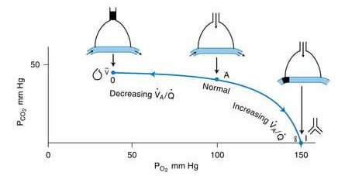
VQ Line
West’s Respiratory Physiology (10th ed)

Slide 8
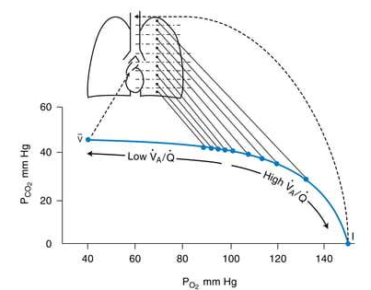
Regional Changes in VQ in the Lung
V ↓
Q ↓
V ↑
Q ↑
West’s Respiratory Physiology (10th ed)

Slide 9
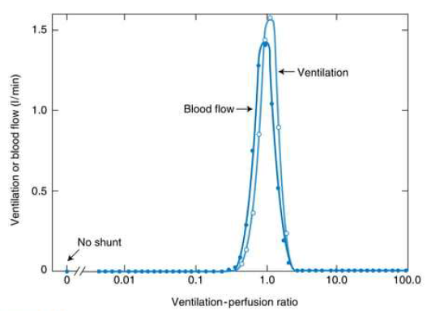
VQ Matching in Healthy Lung
West’s Respiratory Physiology (10th ed)

Slide 10
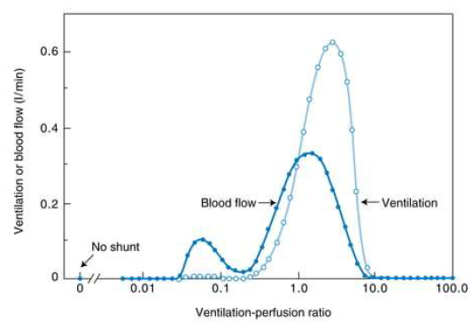
VQ Mismatch in Diseased Lung
West’s Respiratory Physiology (10th ed)

Slide 11
Causes of VQ Mismatch
Lung Disease | Pulmonary Vascular Disease | Miscellaneous
COPD Asthma Bronchiectasis ILD Pneumonia Atelectasis | PE PH PAVMs | Older age PPV
10.4103/0970-2113.197116

Slide 12
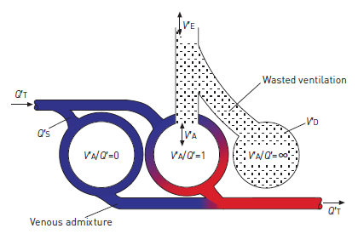
Effect of VQ Mismatch on Gas Exchange
A lung with VQ mismatch is less able to transfer O₂ and CO₂
Less blood flow comes from poorly perfused units with higher P_{A}O₂
Relatively less ventilation of well-perfused units with lower P_{A}O₂
High VQ units add little to O₂ content of blood as Hb saturated
CO₂ removal increases linearly
10.1183/09031936.00037014
10.1080/15412550802522783

Slide 13
Compensatory Mechanisms
Hypoxic pulmonary vasoconstriction
↓ blood flow to low VQ units
In atelectasis, can ↓ blood flow ~50%
Less effective with ↑ region of lung involved
↑ PAP
Hypoxic bronchodilation
Increased ventilatory drive
↓ PCO2 through ↑ ventilation
Minimal ↑ PO2

Slide 14
Measuring VQ Mismatch
Quantitative Estimates | Imaging Techniques | Functional Techniques
Alveolar-Arterial O₂ Tension Difference (P_{A-a}O₂) Venous Admixture Wasted Ventilation P_{a}CO2-P_{ET}CO₂ Difference | SPECT Scan PET Scan MRI | Multiple Inert Gas Elimination Technique (MIGET) Three-Compartment Model (Riley Method)
10.1183/09031936.00037014
https://derangedphysiology.com/main/cicm-primary-exam/respiratory-system/Chapter-0731/methods-measuring-ventilation-perfusion-mismatch

Slide 15
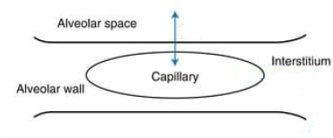
Alveolar-Arterial O2 Tension Difference (PA-aO2)
In health, difference between alveolar and arterial PO₂ is small
Venous admixture
< 15 mmHg (< 2 kPa)
(age / 4) + 4
(age + 10) / 4
↑ with age
P_{a}O₂ measured by ABG
P_{A}O₂ calculated from alveolar gas equation
West’s Respiratory Physiology (10th ed)

Slide 16
Alveolar Gas Equation
P_{A}O₂ = P_{I}O₂ – (P_{A}CO₂ / R) + F
= P_{I}O₂ – (P_{a}CO₂ / 0.8)
= (760 – 47) x 0.21 – (40 / 0.8)
= 150 – 50
= 100 mmHg (13.3 kPa)
P_{I}O₂: (P_{atm} – P_{H2O}) x F_{i}O₂
R: respiratory exchange ratio
0.8
measured
F: correction factor (0)

Slide 17
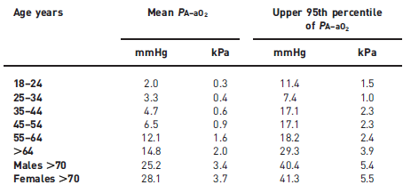
Normal A-a gradient varies at different ages
10.1183/09031936.00037014

Slide 18
Increased A-a Gradient
Low F_{i}O₂ | ✖
Hypoventilation | ✖
Diffusion limitation | ✓
Shunt (no improvement with supplemental O₂) | ✓
VQ mismatch | ✓

Slide 19
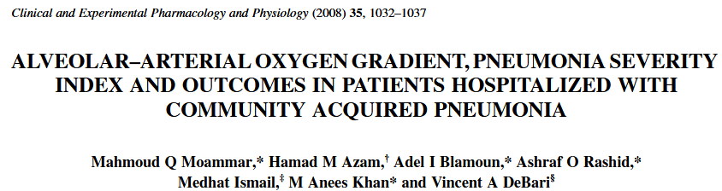
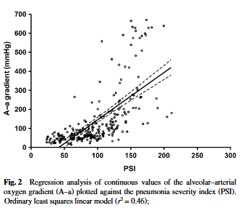
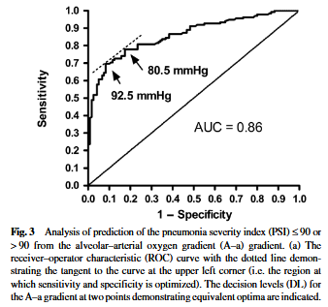
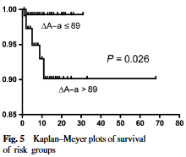
10.1111/j.1440-1681.2008.04971.x

Slide 20
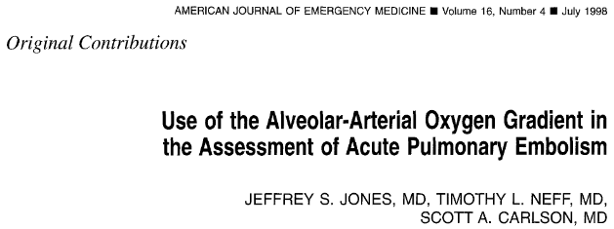
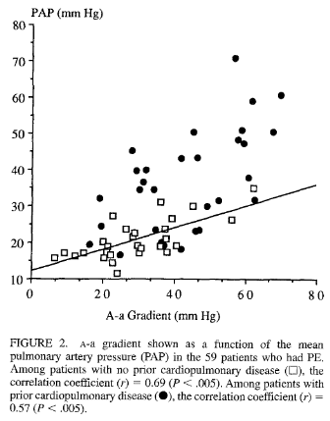
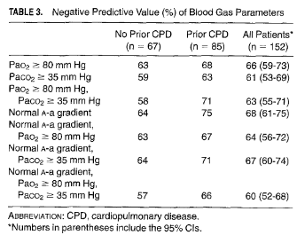
Am J Emerg Med 1998;16:333-33

Slide 21
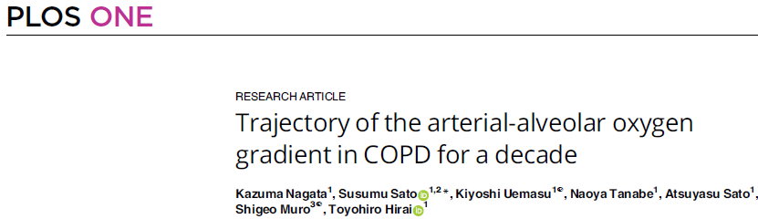
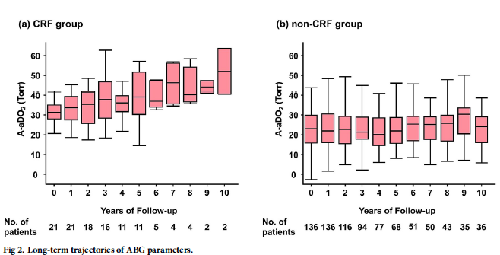
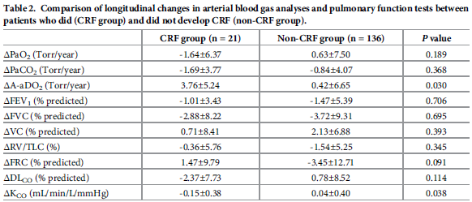
10.1371/journal.pone.0318377

Slide 22
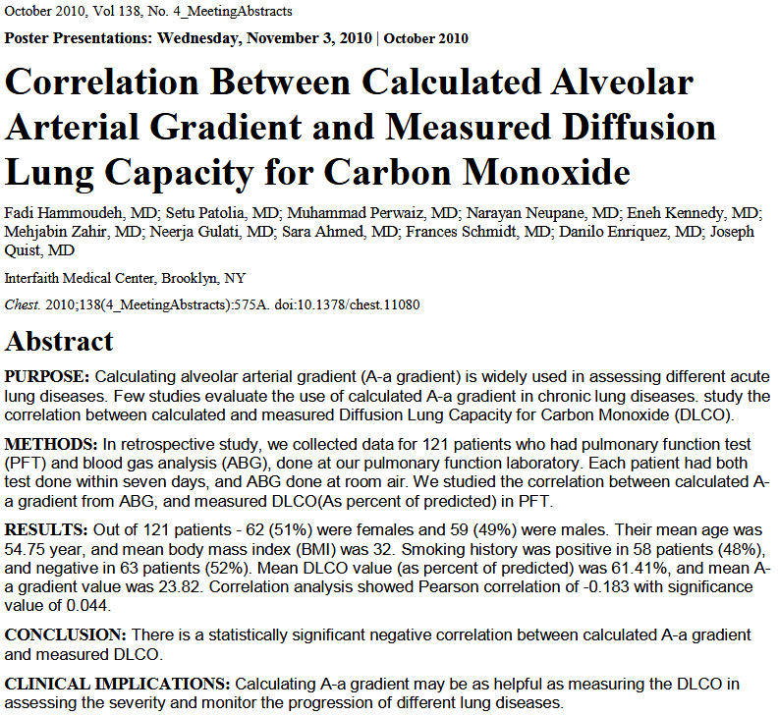
10.1378/chest.11080

Slide 23
Limitations of the A-a gradient
Only valid in steady state conditions
Dependent on F_{i}O₂
Influenced by CVS changes
Assumption of Respiratory Quotient (0.8)
Not reliable in specific conditions:
Severe acidosis
CO poisoning
Altitude

Slide 24
Venous Admixture
The shunt equation:
Q’_{s} = C_{ec}O₂ - C_{a}O₂
Q’_{t} = C_{ec}O₂ - C_{v}O₂
Includes:
True right-to-left shunt
Low V/Q lung units
100% O2 abolishes component from low VQ units
↑ shunt d/t absorption atelectasis

Slide 25
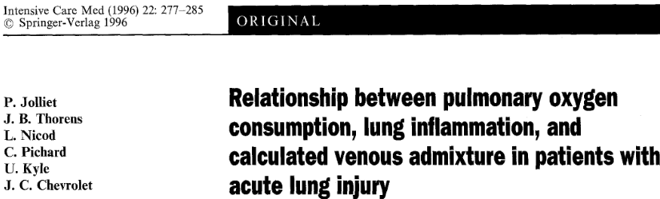
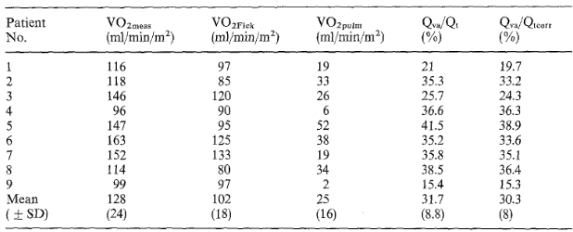
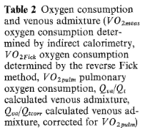
Pulmonary disease/inflammation leads to ↑ VO_{2pulm}
This can affect the shunt equation:
Q’_{s} = C_{ec}O₂ - C_{a}O₂ – (VO_{2pulm} / Q’_{t})
Q’_{t} = C_{ec}O₂ - C_{v}O₂ .
4.2% overestimation with classical formula
No correlation with or VO_{2pulm} in lung injury
VO_{2max}?
Intensive Care Med (1996) 22:277-285

Slide 26
Wasted Ventilation
Total dead space that would cause the observed impairment in CO₂ elimination:
Anatomical dead space (upper airways, trachea, proximal bronchi)
Alveolar dead space
High VQ units
V_{D}/V_{T}
(P_{A}CO₂ – P_{E}CO₂) / P_{A}CO₂
P_{A}CO₂ ≈ P_{a}CO₂
Normal V_{D} is ~150 mL (¹/₃)
↑ Minute ventilation (V’_{E}) (necessitated by ↑ V_{D})
Ventilatory ratio: V’_{E} x P_{a}CO₂ / (IBW x 100 x 37.5)
Denominator: predicted V’_{E} x predicted P_{a}CO₂
V’_{E} /V’_{CO2}
Measures of wasted ventilation can estimate the effect of VQ mismatch on V’_{E}
Limitations:
Shunts (and diffusion impairment) ↑ P_{a}CO₂ and ∴ apparent dead space
Normal values affected by age, sex, body size and posture

Slide 27
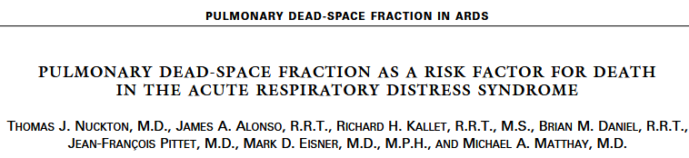
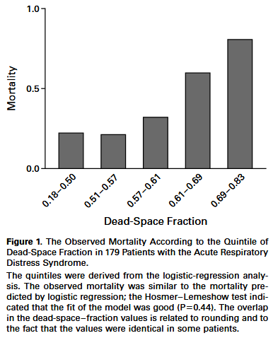
10.1056/NEJMoa012835

Slide 28
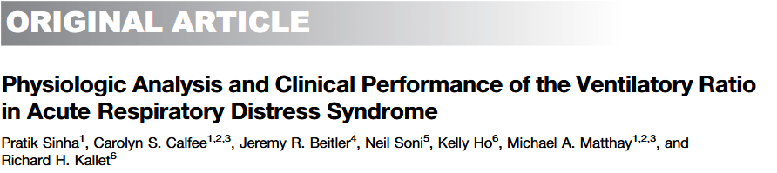
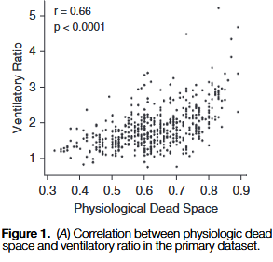
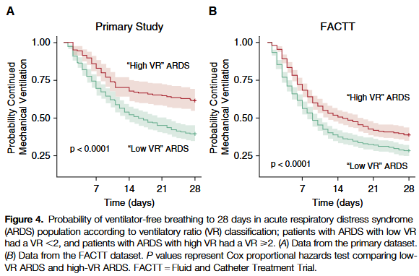
10.1056/NEJMoa012835

Slide 29
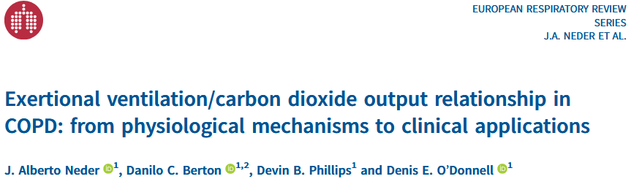
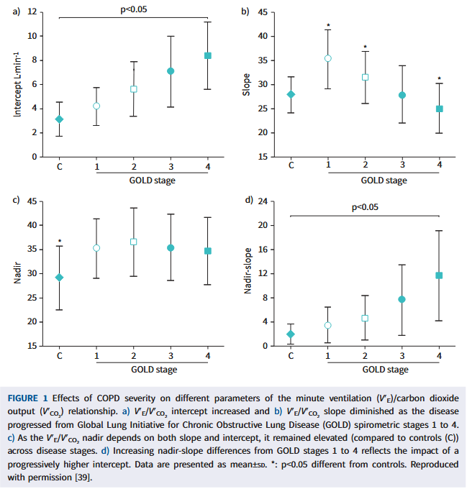
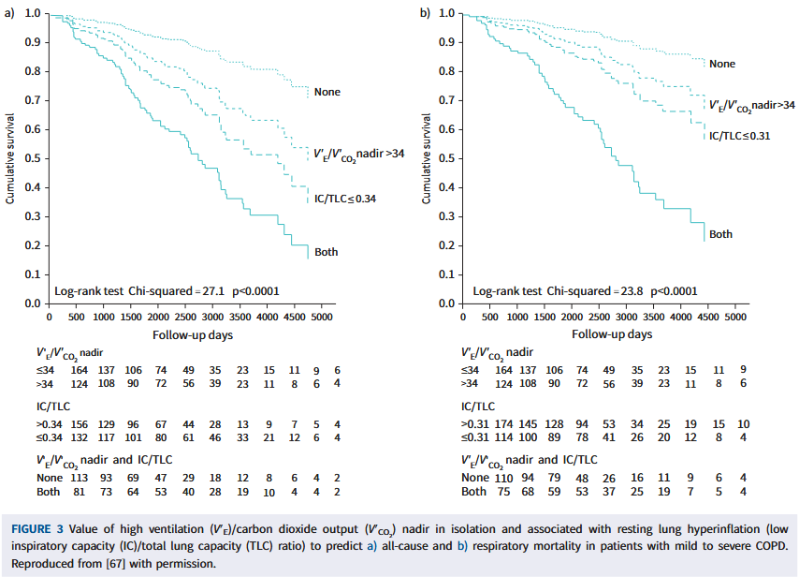
10.1183/16000617.0190-2020

Slide 30
P_{a}CO2-P_{ET}CO₂ Difference
P_{ET}CO₂ ≈ P_{A}CO₂
Final portion of exhaled gas = mixed alveolar gas
Estimates extent of high VQ and alveolar dead space regions
Excludes anatomical dead space
Normal: < 5 mmHg (0.7 kPa)
Correlates with wasted ventilation
↓ correlation vs fractions
P_{ET}CO₂ / P_{a}CO₂
Late emptying of low VQ units may ↑ P_{ET}CO₂ and ↓ the difference

Slide 31
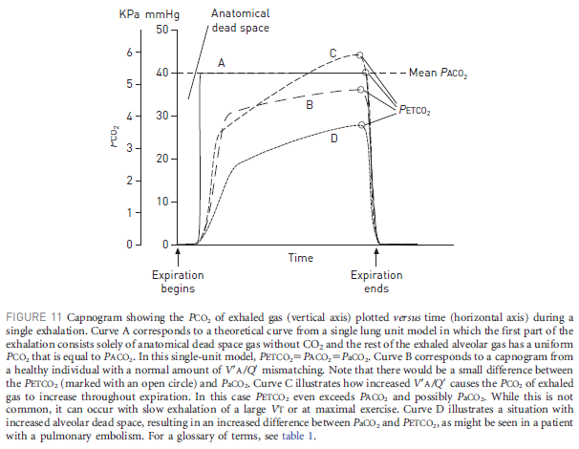
P_{a}CO2-P_{ET}CO₂ Difference
10.1183/09031936.00037014

Slide 32
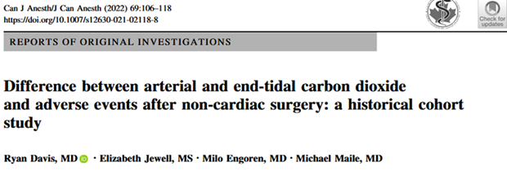
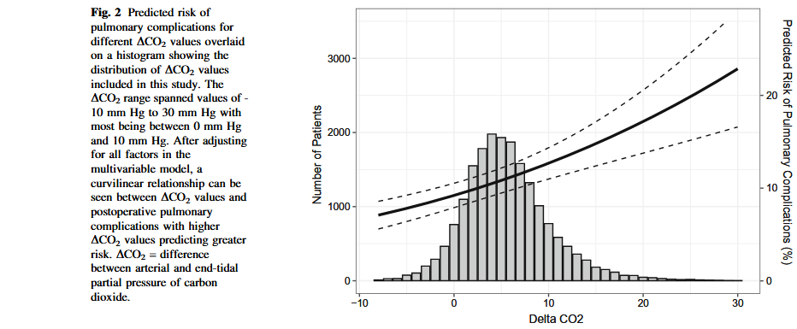
10.1007/s12630-021-02118-8

Slide 33
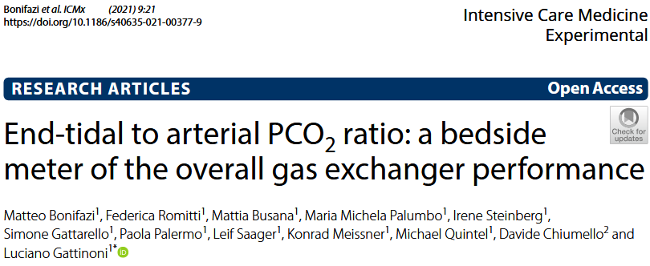
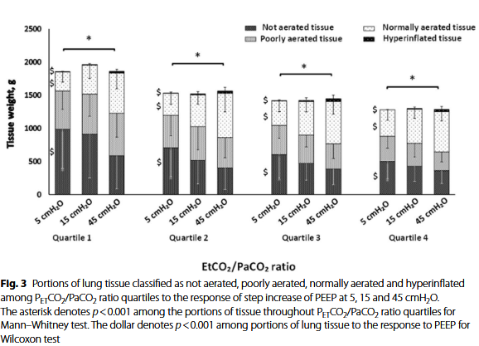
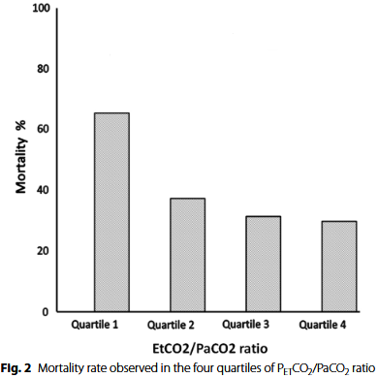
10.1186/s40635-021-00377-9

Slide 34
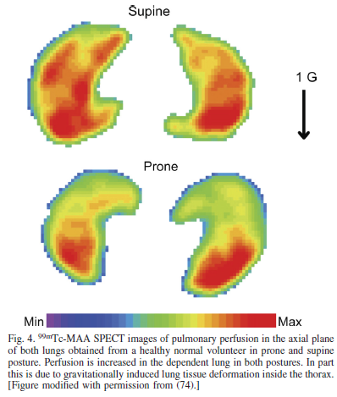
SPECT Scan
Radioactive tracers:
Inhalation of ¹³³Xe or ⁸¹Kr
Shorter half-life of ⁸¹Kr
IV ¹³³Xe or ⁹⁹Tc
⁹⁹Tc has a small size and is distributed to the capillary beds
Distributions recorded with gamma camera
Acquisition: several minutes
Low resolution
↑ radiation exposure
10.1152/japplphysiol.00320.2012

Slide 35
PET Scan
Radioactive isotopes injected, eg. ¹³N₂
Moves into alveolar space
Decays and emits photons
3D measurements during normal breathing
Local concentration reflects local perfusion (not bulk flow)
Acquisition: breath hold
Resolution: < 1 cm³
10 – 20 cm: doesn’t contain entire thorax
↓ radiation exposure

Slide 36
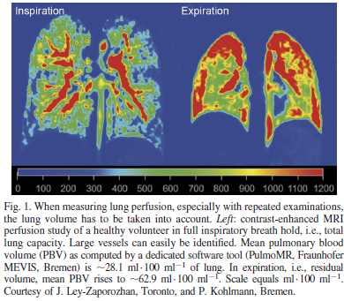
MRI
Inhaled tracer gases:
Hyperpolarised ³He or ¹²⁹Xe
O₂
Fluoride-containing gases
IV gadolinium compounds
Acquisition: 1.5 s – breath hold
High resolution of regional ventilation and perfusion
Perfusion: subsegmental level (incorporates larger vessels)
Quantification difficult due to problems with signal intensity
No radiation
10.1152/japplphysiol.00320.2012

Slide 37
CT Scan
Repeated scanning with multidetector CT
Dual-energy CT
Semi-quantitative
Clinically used in detection of perfusion defects

Slide 38
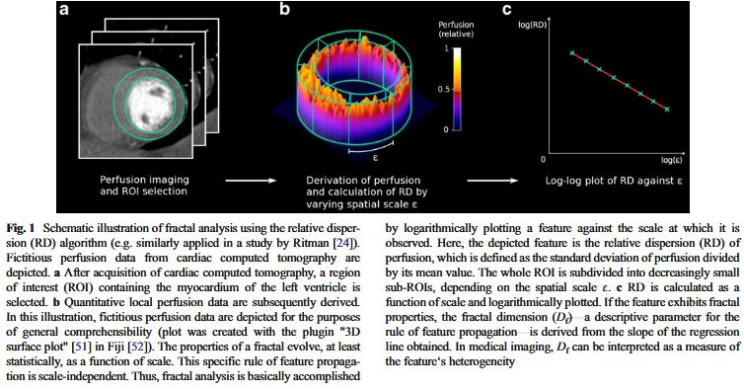
Measurements
Large dataset rather than a single measure
Spatial gradients
Relative dispersion (SD)
Fractal analysis
Cluster analysis
Spatial correlation
10.1007/s00330-013-2977-9

Slide 39
Challenges with Imaging Techniques
Inspiration vs Expiration
Pulmonary blood flow doubles during expiration
↑ air → ↓ signal intensity during inspiration
L/g
Apico-basal and antero-posterior gradients
Breath holding
↑ CO2 may cause small changes in regional perfusion
Respiratory and cardiac motion
Gating
Resolution
Artefacts
Combining images from different modalities, eg. PET-CT
Not fully validated

Slide 40
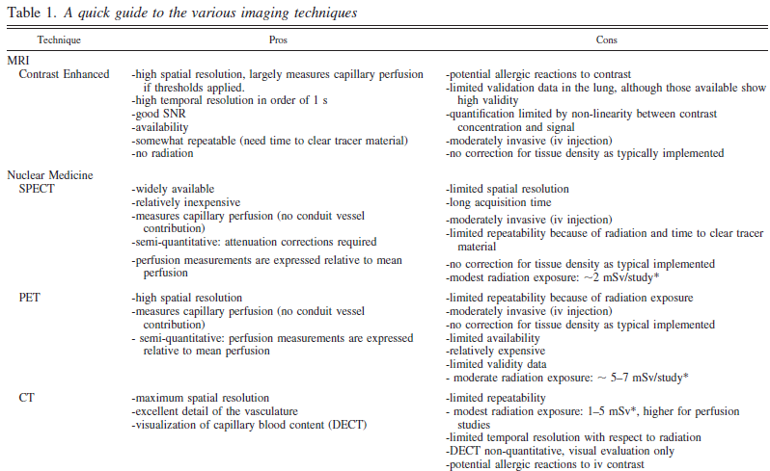
Imaging Summary
10.1152/japplphysiol.00320.2012

Slide 41
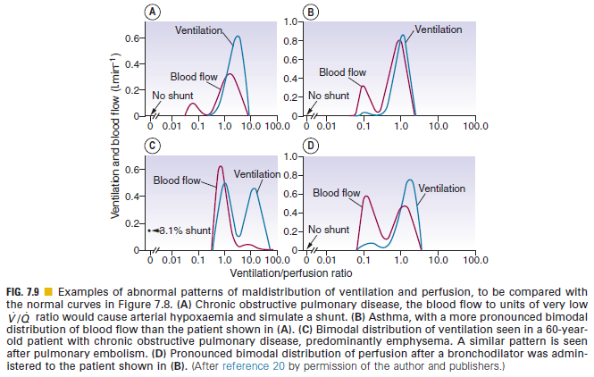
Multiple Inert Gas Technique
Technically difficult procedure
Six tracer gases with different solubility
Acetone
Sulphur hexafluoride
Given in a constant-rate saline infusion until equilibrium
Concentrations:
Measured in arterial blood
Derived in mixed venous blood via Fick principle
Retention and elimination in the lung calculated
Distribution curves for V and Q derived
Defined by ratio rather than anatomy
Between 0.5 and 2 in young, healthy adult
Characteristic patterns in pathologic conditions
Nunn’s Applied Respiratory Physiology (8th ed)

Slide 42
Three-Compartment Model
Described by Riley & Cournard (1940’s)
Lung considered to have 3 compartments:
Dead space
Shunt
Ideal VQ
Values readily determined through blood and gas analysis

Slide 43
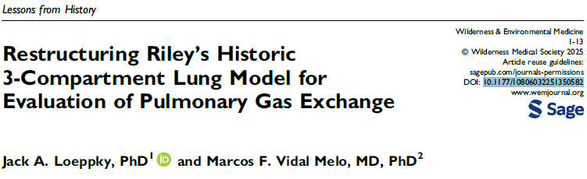
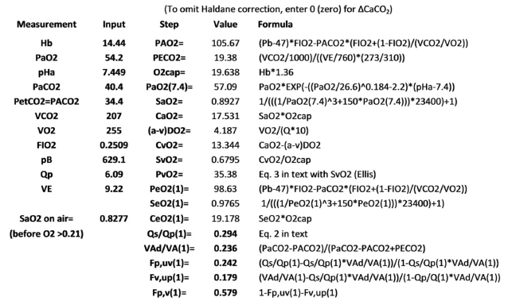
10.1177/10806032251350582

Slide 44
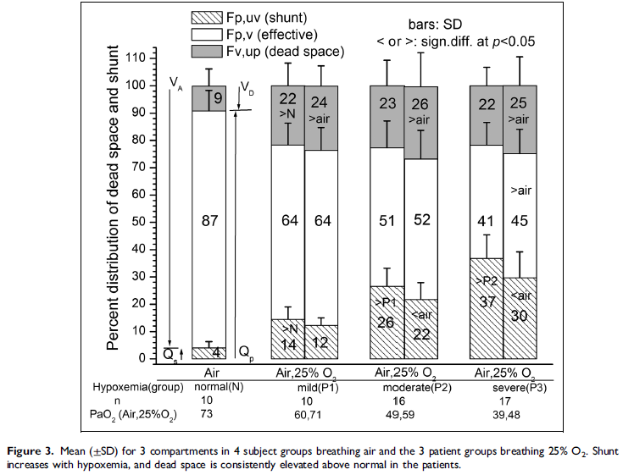
10.1177/10806032251350582

Slide 45


Thank you Enkosi Dankie
Photo by Stefan Els

